Slide 1
A New Model
Song An Nguyen – Thuc Nguyen

Slide 2
Notations
Let
x₁(t): number of infections of District 1 at t^{th} day.
x₂(t): number of infections of District 2 at t^{th} day.
…
x_{n}(t): number of infections of District n at t^{th} day.
Let
x(t) = (x₁(t), x₂(t), …, x_{n}(t)): vector of infections of districts at t^{th} day.

Slide 3
Prediction
Suppose that we have the weight matrix W = [w_{ij}], 1 ≤ i, j ≤ n and B = [b_{i}], 1 ≤ i ≤ n.
Given vector of infections at t^{th} day
x(t) = (x₁(t), x₂(t), …, x_{n}(t))
To predict infections a (t+1)^{th} day, for all 1≤ j ≤ n, we compute
y_{j} = w_{1j}*x₁(t) + w_{2j}*x₂(t) + … + w_{nj}*x_{n}(t)
x_{j}(t+1) = (h(y_{j}) + b_{j})*x_{j}(t);
where h(u)=(e^{u}-e^{-u})/(e^{u}+e^{-u})

Slide 4
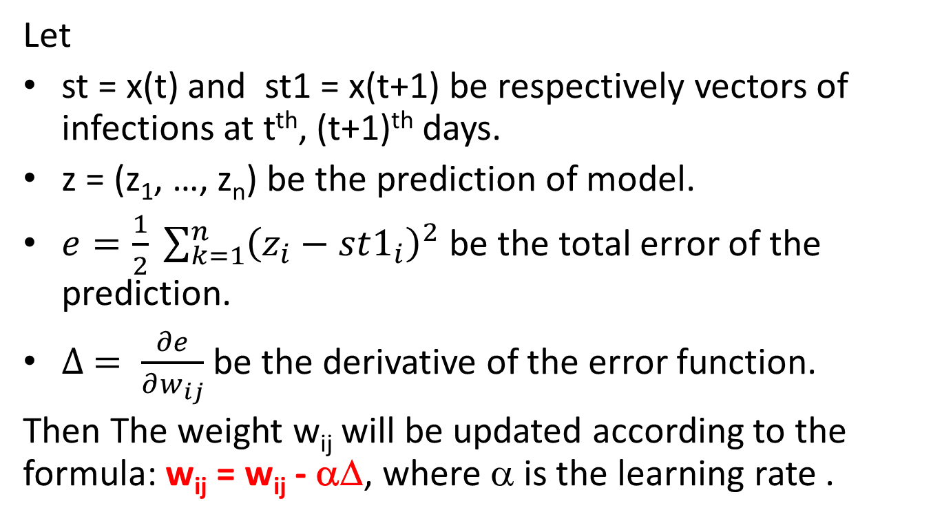
Learning rule
Let
st = x(t) and st1 = x(t+1) be respectively vectors of infections at t^{th}, (t+1)^{th} days.
z = (z₁, …, z_{n}) be the prediction of model.
$e=\frac{1}{2} \sum_{k=1}^{n}{{\left(z_{i}−st1_{i}\right)}^{2}}$ be the total error of the prediction.
$∆ = \frac{∂e}{∂w_{ij}}$ be the derivative of the error function.
Then The weight w_{ij} will be updated according to the formula: w_{ij} = w_{ij} - αΔ, where α is the learning rate .

Slide 5
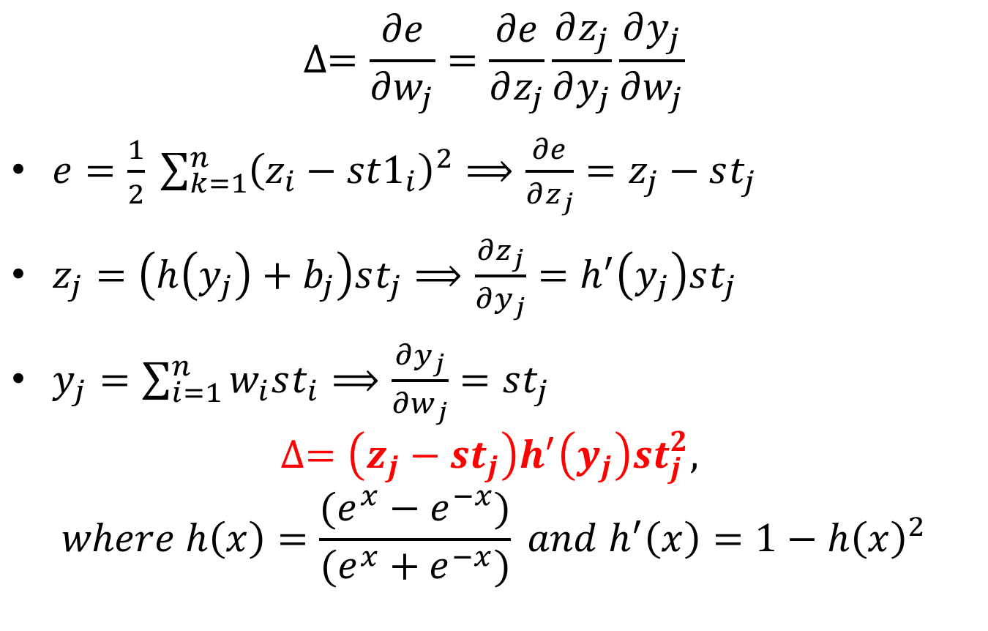
Derivative of the error function
$$∆=\frac{∂e}{∂w_{j}}=\frac{∂e}{∂z_{j}}\frac{∂z_{j}}{∂y_{j}}\frac{∂y_{j}}{∂w_{j}}$$
$e=\frac{1}{2} \sum_{k=1}^{n}{{\left(z_{i}−st1_{i}\right)}^{2}}⟹\frac{∂e}{∂z_{j}}=z_{j}−st_{j}$
$z_{j}=\left(h\left(y_{j}\right)+b_{j}\right)st_{j}⟹\frac{∂z_{j}}{∂y_{j}}=h^{′}\left(y_{j}\right)st_{j}$
$y_{j}=\sum_{i=1}^{n}{w_{i}st_{i}}⟹\frac{∂y_{j}}{∂w_{j}}=st_{j}$
$$∆=\left(z_{j}−st_{j}\right)h^{′}\left(y_{j}\right)st_{j}^{2},$$
$$where h\left(x\right)=\frac{(e^{x}−e^{−x})}{(e^{x}+e^{−x})} and h^{′}\left(x\right)=1−h{\left(x\right)}^{2}$$

Slide 6
Learning algorithm
Given dataset Ω = {x(t)=(x₁(t),…, x_{n}(t)), 1≤t≤N}, the weight matrix is defined as following:
(1) For (i,j = 1 to n): w_{ij} = Random(-1,1)
(2) For (epoch = 1 to 1000):
For (t = 1 to N-1):
st = x(t); st1 = x(t+1)
For (j=1 to n):
yj = 0
For (i=1 to n): yj = yj + w[i][j]*st[i]
zj = (h(yj) + b[j])*st(j)
Δ = α*(yj – st1[j])*st[j]*h’(yj)
For (i=1 to n): w[i][j] = w[i][j] + Δ
b[j] = b[j] + Δ
(3) Return weight matrix W and column vector B

Slide 7
More about the rate learning
In the updated weight formula w = w + c, where the weight variation c = αΔ depends on the learning rate, which is a constant.
A constant rate learning maybe is not good for the convergence of the algorithm because the process will oscillate around the local minima of the error function.
Therefore an adaptive rate learning will be better.

Slide 8

The adaptive rate learning
To find the local minima of the error function, we assume that the error function is a parabola then the minima will have a derivative of 0.
Let Δ(t) be the derivative value at the current iterative epoch, then Δ(t+1) will be zero.
So the weight variation can be defined by
Error function
c(t-1)
$$\frac{c(t)}{c(t−1)}=\frac{∆\left(t\right)−∆(t+1)}{∆\left(t−1\right)−∆(t)}$$
$$c\left(t\right)=\frac{∆\left(t\right)}{∆\left(t−1\right)−∆\left(t\right)}c\left(t−1\right)$$
Δ_{t-1}
c(t)
Δ_{t+1}
Δ_{t}

